Slide 1
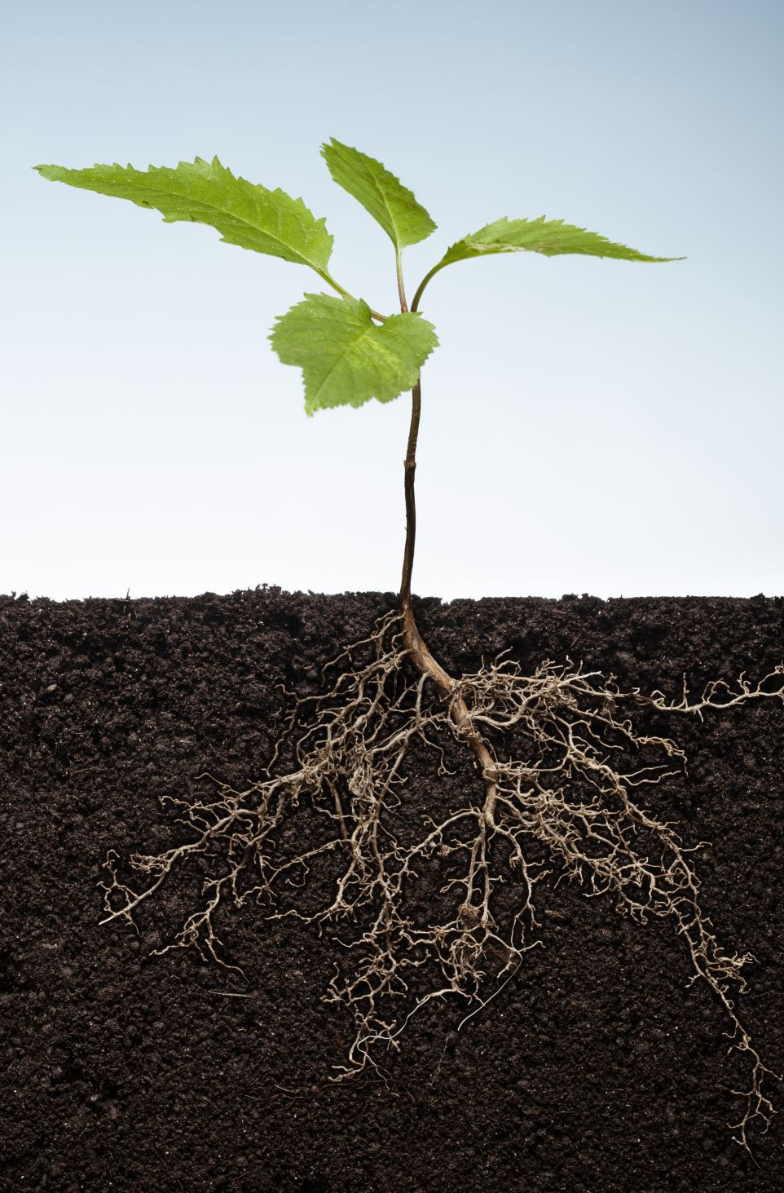
Pattern Recognition ECSE 4410/6410 CAPA Spring 2021 Support Vector Machines
Lectures #36/37
Week #15
Course Instructor - Thirimachos Bourlai
January to May 2021
Please Check the 2021 Syllabus

Slide 2
OVERVIEW
Understand the SVM different names
SVM representation when the model is stored on disk
How a learned SVM model representation can be used to make predictions for new data
How to learn an SVM model from training data
How to best prepare your data to apply SVM

Slide 3
SVMs
One of the most popular and talked about machine learning algorithms
Extremely popular around the time they were developed (1990s)
Continue to be the go-to method for a high-performing algorithm with little tuning

Slide 4
Maximal-Margin Classifier
It is a hypothetical classifier → best explains how SVM works in practice
An n-D space is formed by the numeric input variables (x) in our data
Say we have 2 input variables → 2-D space
A hyperplane is a line that splits the input variable space
In SVM → we select a hyperplane to separate (ideally) the points in the input variable space based on their class → class 0 vs. class 1

Slide 5
Maximal-Margin Classifier
2-D Space – Example:
The boundary is a line
Let's assume that all our input points can be completely separated by this line
For example: B₀ + (B₁ × X₁) + (B₂ × X₂) = 0, where
The coefficients (B1; B2): slope of the line, and (B0): intercept are found by the learning algorithm
X1 and X2: are the two input variables
We can classify using this line: we add input values into the line equation → calculate whether a new point is above or below the line

Slide 6
Maximal-Margin Classifier
B₀ + (B₁ × X₁) + (B₂ × X₂) = 0
Above the line, the equation returns a value greater than 0 and the point belongs to the 1st class → class = 0
Below the line, the equation returns a value less than 0 and the point belongs to the 2nd class → class = 1
A value close to the line returns a value close to zero and the point may be difficult to classify
If the magnitude of the value is large, the model may have more confidence in the prediction

Slide 7
Maximal-Margin Classifier
B₀ + (B₁ × X₁) + (B₂ × X₂) = 0
The distance between the line and the closest data points is referred to as the margin
The optimal line that can separate the two classes is the line that has the largest margin → called the Maximal-Margin hyperplane
How is the margin calculated? As the perpendicular distance from the line to only the closest points.
Notes:
As the perpendicular distance from the line to only the closest points. Only these points (called support vectors) are relevant in defining the line and in the construction of the classifier. SV: support or define the hyperplane, which is learned from training data using an optimization procedure that maximizes the margin.

Slide 8
Soft Margin Classifier
In practice, real data is challenging to be separated perfectly well with a hyperplane
Thus: we need to relax the constraint of maximizing the margin of the line that separates the classes → namely, we need to use a Soft Margin Classifier (SMC)
SMC: allows some training data points to violate the dichotomizer
More coefficients (called slack variables) are introduced that give the margin wiggle room in each dimension --> thus, model complexity increases (we have more parameters to fit to the data)

Slide 9
Soft Margin Classifier
There is a tuning parameter (C):
Defines the magnitude of the wiggle allowed across all dimensions; the amount of violation of the margin allowed
If C = 0 → no violation → use the Maximal-Margin Classifier (described before)
The larger the value of C → more violations of the hyperplane are permitted

Slide 10
Support Vector Machines (Kernels)
SVM: implemented in practice using a kernel.
The learning of the hyperplane in linear SVM:
We do that by transforming the problem using linear algebra
Linear SVM can be rephrased using the inner product of any two given observations, rather than the observations themselves.
Inner product between two vectors:
It is the sum of the multiplication of each pair of input values
E.g. the inner product of the vectors [2; 3] and [5; 6] is 2 x 5 + 3 x 6 = 28

Slide 11
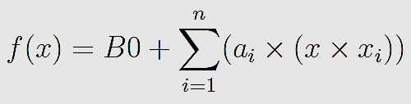
Support Vector Machines (Kernels)
Making a prediction for a new input → we need to use the dot product between the input (x) and each support vector (x_{i}).
Here is the equation:
We calculate the inner product of -- a new input vector (x) with all support vectors in the training set
Coefficients: B0 and a_{i} (for each input) are estimated from the training data by the learning algorithm

Slide 12

Linear Kernel SVM
The dot-product is called the kernel and can be re-written as:
The kernel defines the similarity or a distance measure between new data and the support vectors
The dot product is the similarity measure used for linear SVM or a linear kernel because the distance is a linear combination of the inputs.

Slide 13
Linear Kernel SVM
Other kernels can be used that transform the input space into higher dimensions such as a Polynomial Kernel and a Radial Kernel
It is desirable to use more complex kernels → it allows lines to separate the classes that are curved or even more complex
More complex kernels → CAN (problem dependent) lead to more accurate classifiers
Notes:
Let’s talk about these kernels

Slide 14

Polynomial Kernel SVM
Where the degree of the polynomial must be specified by hand to the learning algorithm (d>1)
When d = 1 → we have the linear kernel
The polynomial kernel allows for curved lines in the input space

Slide 15

Radial Kernel SVM
gamma → a parameter that must be specified to the learning algorithm
gamma is often 0 < gamma < 1
Default value for gamma = 0.1
The radial kernel is very local and can create complex regions within the feature space, like closed polygons in a two-dimensional space

Slide 16
How to Learn a SVM Model
SVM model: it is solved using an optimization procedure
A Numerical Optimization Procedure (NOP) can be used to search for the coefficients of the hyperplane
This can result in an inefficient solution
NOP is not the approach preferred in widely used SVM implementations like LIBSVM

Slide 17
How to Learn a SVM Model
Specialized optimization procedures can re-formulate the optimization problem to be a Quadratic Programming problem
The most popular method for fitting SVM is the Sequential Minimal Optimization (SMO) method that is very efficient
It breaks the problem down into sub-problems that can be solved analytically (by calculating) rather than numerically (by searching or optimizing)

Slide 18
Preparing Data for SVM
Numerical Inputs:
SVM assumes numeric input
For categorical inputs → we may need to covert them to binary dummy variables (one variable for each category)
Binary Classification:
Basic SVM is intended for binary (two-class) classification problems
There are SVM extensions developed for regression and multiclass classification

Slide 19
Quiz
The Maximal-Margin Classier that provides a simple theoretical model for understanding ____________(?)
The _____________Classifier which is a modification of the Maximal-Margin Classier to relax the margin to handle noisy class boundaries in real data
Support Vector Machines:
the learning algorithm can be reformulated as a _________ kernel
other kernels like ______________ and _____________ can be used
How you can use numerical optimization to learn the hyperplane and that efficient implementations use an alternate optimization scheme called ____________________.
Notes:
The Maximal-Margin Classier that provides a simple theoretical model for understanding SVM
The Soft Margin Classier which is a modification of the Maximal-Margin Classier to relax the margin to handle noisy class boundaries in real data
Support Vector Machines and how the learning algorithm can be reformulated as a dot-product kernel and how other kernels like Polynomial and Radial can be used
How you can use numerical optimization to learn the hyperplane and that efficient implementations use an alternate optimization scheme called Sequential Minimal Optimization.

Slide 20
Support Vector Machine Tutorial
What we will discuss:
The use of sub-gradient descent (variation of gradient descent) to update the coefficients for an SVM model
The interstation of the sub-GD algorithm to learn an SVM model for training data
Given a learned SVM model→ make predictions

Slide 21
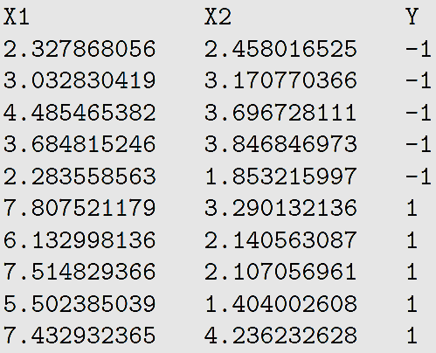
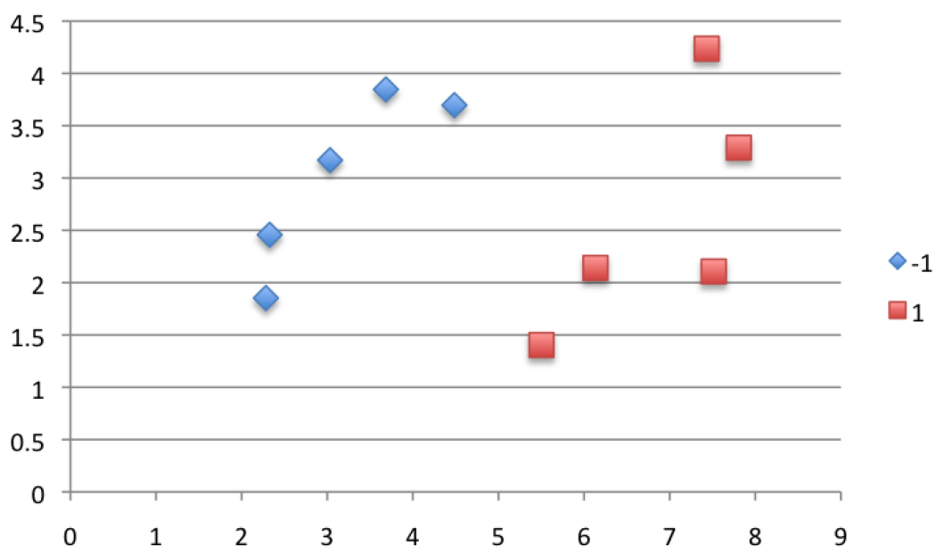
Tutorial DATASET
Test problem: devised so that the classes are linearly separable (via a straight line)
This is intentional so that we can explore how to implement an SVM with a linear kernel
An assumption made by the SVM algorithm is that:
The 1st class value is …. -1
The 2nd class value is … +1

Slide 22
Training SVM With Gradient Descent 1. Form of Linear SVM Model
The Linear SVM model is a line
The goal of the learning algorithm is to compute the coefficients values that results in a line that best separates the classes
The line is typically in the form:
B0 + (B1 × X1) + (B2 × X2) = 0
B0, B1 and B2: coefficients; X1, X2: input variables
Say we drop the bias term (B0 = 0) -- also called the offset or intercept:
(B1 × X1) + (B2 × X2) = 0
This means that the line will pass through the origin (X1 = 0 and X2 = 0)

Slide 23
Training SVM With Gradient Descent 2. SVM Optimization Method – to find the coefficients
Optimization algorithm → can be stated as a quadratic programming problem
This is a type of constraint optimization where fast solvers can be used (outside the scope of the lecture – will use a different approach for Linear SVM i.e., sub-gradient descent
Sub-GD:
A random training pattern is selected in each iteration
The pattern is used to update the coefficients
After a large # of iterations (1000s – 100s of thousands) the algorithm converges on a stable set of coefficients

Slide 24
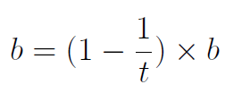
Training SVM With Gradient Descent 2. SVM Optimization Method – to find the coefficients
The coefficient update equation works as follows.
First an output value is calculated as:
output = Y x ((B1 x X1) + (B2 x X2))
Two different update procedures are used depending on the output value
If "output value“ >1 --> the training pattern is not a support vector
This means that the instance was NOT directly involved in calculating the output, in which case the weights are slightly decreased:
1
“b” is the weight that is being updated (such as B1 or B2)
“t” is the current iteration (e.g. 1 for the 1st update, 2 for the 2nd update etc.)

Slide 25
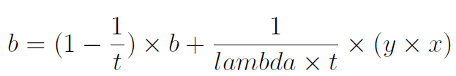
Training SVM With Gradient Descent 2. SVM Optimization Method – to find the coefficients
2
If the “output” < 1 → the training instance is a support vector and must be updated to better explain the data.
b = the weight that is being updated
t = current iteration
lambda = learning algorithm parameter [often set to very small values, e.g. <=0.0001
3
The procedure is repeated until the error rate drops to a desirable level OR for a very large fixed number of iterations
Smaller learning rates → require much longer training times
The number of iterations is a downside to this learning algorithm.

Slide 26
Training SVM With Gradient Descent 3. Learn an SVM Model from Training Data
Learning Iteration #1
We will start by setting the coefficients to 0.0
B1 = 0.0
B2 = 0.0
We also need to keep track of which iteration we are on: t = 1
Train the model using the order of the training patterns → the order of the patterns is randomized to avoid the learning algorithm getting stuck
The 1st training pattern we will use to update the coefficients is:
Instance: X1 = 2.32, X2 = 2.45, Y = -1
We can now calculate the output value for this iteration.
Notes:
In this section we will work through a few updates to the coecients to demonstrate the SVM
learning algorithm. We will use a very large lambda value: lambda = 0:45. This is unusually
large and will force a lot of change on each update. Normally lambda values are very small.

Slide 27
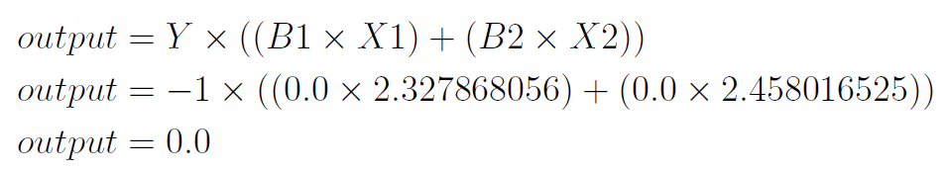
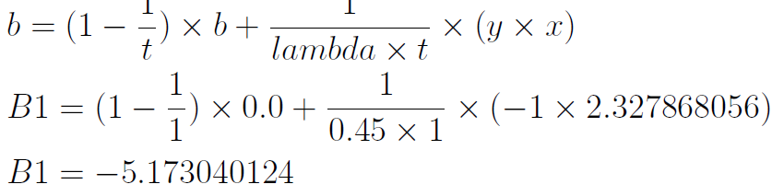
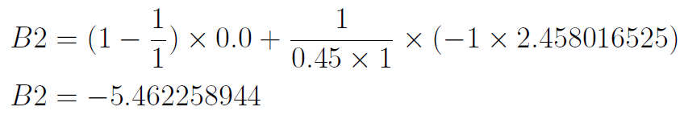
Training SVM With Gradient Descent 1. Form of Linear SVM Model
Learning Iteration #1
< 1
… assumes the training pattern is a support vector:

Slide 28
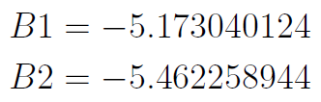
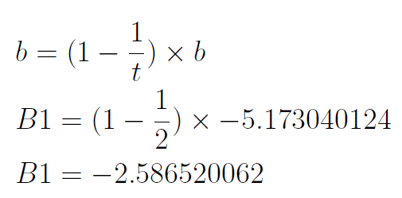
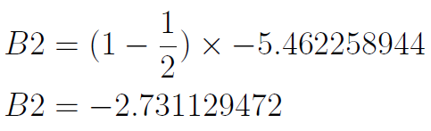
Linear Kernel SVM
Learning Iteration #2
Iteration #2 of the learning algorithm
Use the 2nd instance from the training dataset → t = 2
Instance: X1 = 3.03; X2 = 3.17, Y = -1
> 1 → not a support vector
Update B1 and B2

Slide 29
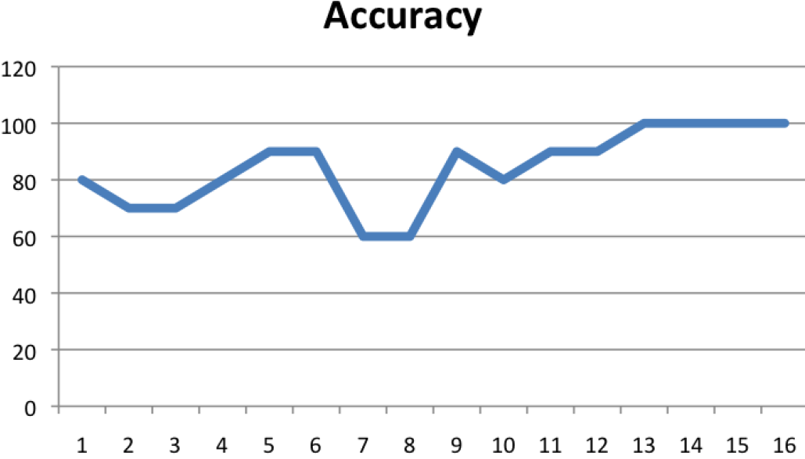
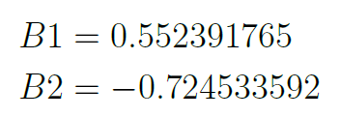
Linear Kernel SVM
Learning Iteration #>3 → more iterations
We repeat this process for the rest of the training instances (training dataset)
We repeat the process for a further 15 epochs for a total of 160 iterations, i.e. 16 epochs, 10 updates per epoch
Epoch = One pass through the complete dataset
We keep track of the loss or the accuracy of the model for each epoch → good way to see whether the algorithm is converging or not
Plot the accuracy vs epochs →
Final coefficient values
We achieve an accuracy of 100% on the training data, after 16 epochs
Final form of the learned hyperplane :
0 + (0.55 × X1) + (-0.72 × X2) = 0

Slide 30
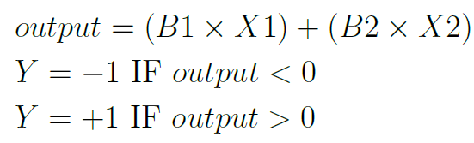
Linear Kernel SVM
Next: Make Predictions with the established SVM Model
Now that we have coefficients for the line, we can make predictions.
Here we show how to make predictions for the training data
We can easily adapt the process to make predictions for new data
Predictions can be made using the following equation:

Slide 31
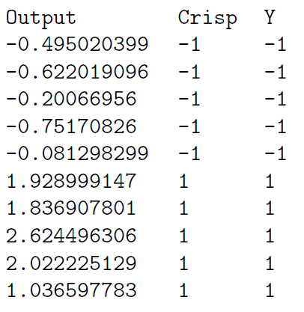
Linear Kernel SVM
Let’s make a prediction for each instance in the training dataset:
Dataset
Accuracy of the Learned SVM Model
Compare:
crisp prediction (Crisp)
expected output column (Y )
We can see that our model has achieved 100% accuracy
Predictions Rule

Slide 32
Linear Kernel SVM
Summary
In this lecture we learned how to implement the SVM algorithm from scratch using the sub-gradient descent optimization technique
We learned:
Update coefficient values for SVM
Iterate the sub-gradient descent procedure to find good coefficient values
Make predictions using a learned SVM model

Slide 33
Questions?
Thank you!

